Slide 1


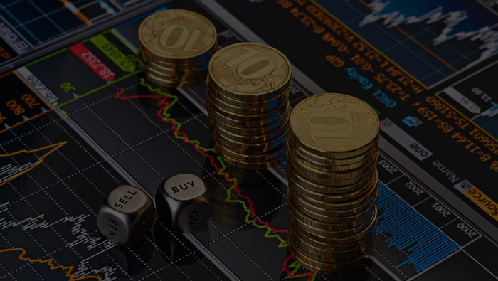
Slide 1
Predicting/classifying future price of currency pairs
ECEC 487
Ananiya Deneke

Slide 2
Slide 5
Introduction
One of the biggest issues in trading (Technical Analysis) is predicting future trends
Pattern recognition can be used as a great tool in identifying these trends
Past price action/data can be used to predict future price of a currency pair or company stock using ML algorithms
Price prediction could be a great input in the decisions involved in trading or investments
1

Slide 3
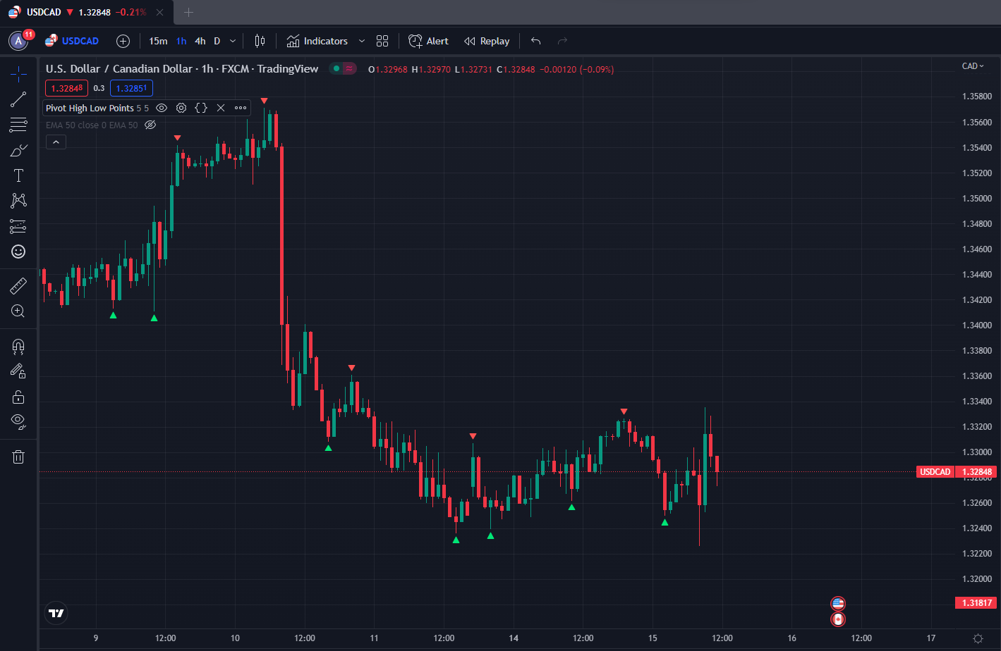
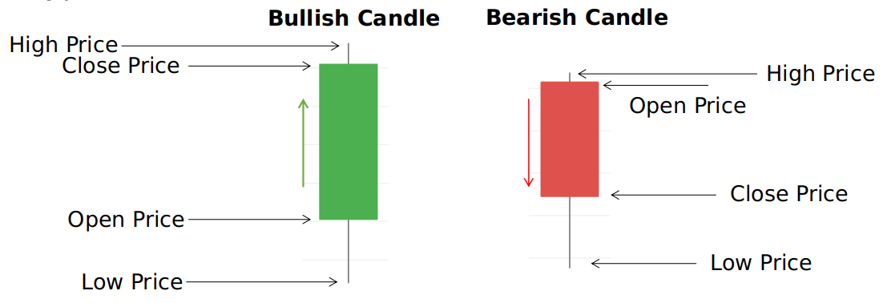
Slide 2
DATA SETS
USDCAD hourly price action(TradingView.com
The data set I used for this sample model consisted of the Canadian Dollar’s price action against the US dollar index.
Each hourly candle represents the previous hour’s high, low, open, and close price.
We’ll be using 24 of these past hourly candles, equivalent to 1 daily candle, to classify/predict the next hour’s price of this currency pair.
2

Slide 4
Slide 5
Classes & Validation
The two classes we’re going to be using are called HIGH & LOW.
HIGH class is for currency pairs/stocks that go up compared to the price at the previous hour.
LOW class is for currency pairs/stocks that go down compared to the price at the previous time stamp.
We validate the data by comparing the predicted price to the observed price after the hour.
1

Slide 5
Slide 4
Impacts
Clear understanding on how money works
Earn Passive income
Fuels economical growth
Raises living standards
Helps companies raise capital
4

Slide 6

Slide 11
THANK YOU

